Slide 1
SEQUENCES AND SERIES
(SEQUENCES AND SERIES)
DR ILOJIDE E.

Slide 2
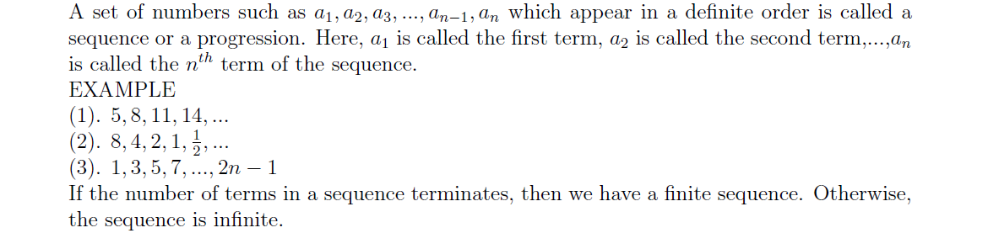
INRODUCTION

Slide 3
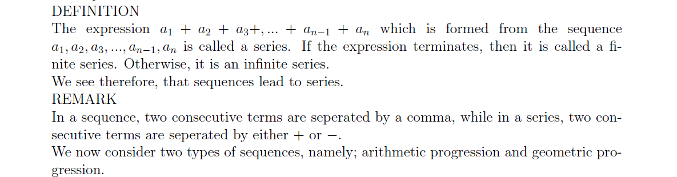
SEQUENCE

Slide 4
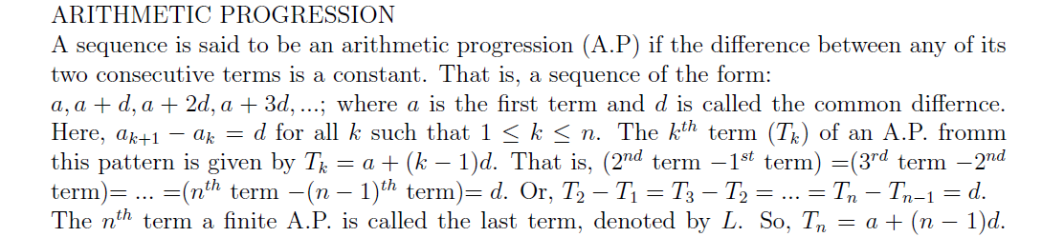
ARITHMETIC PROGRESSION

Slide 5
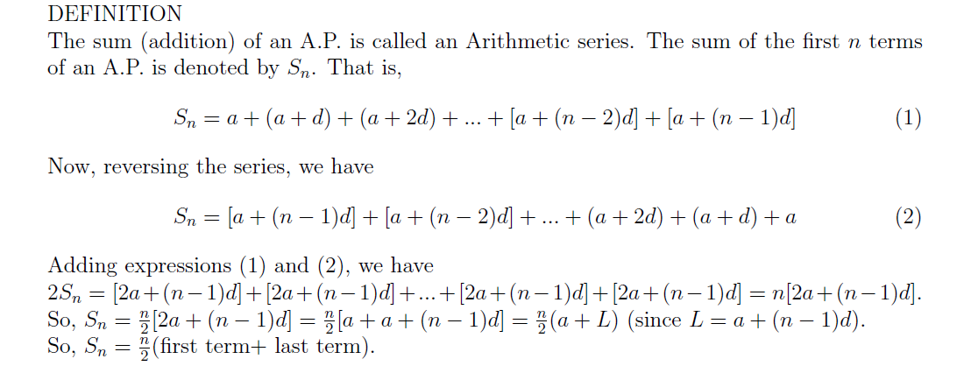
ARITHMETIC SERIES

Slide 6
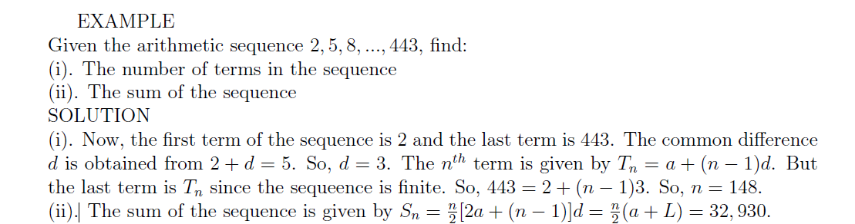
EXAMPLE

Slide 7
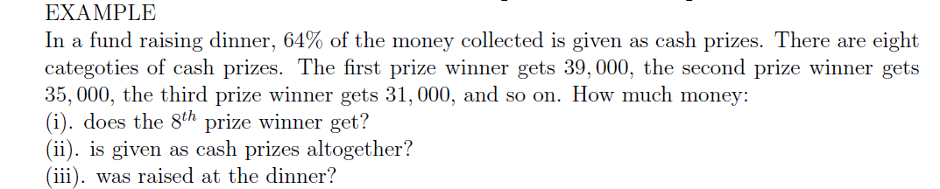
EXAMPLE

Slide 8
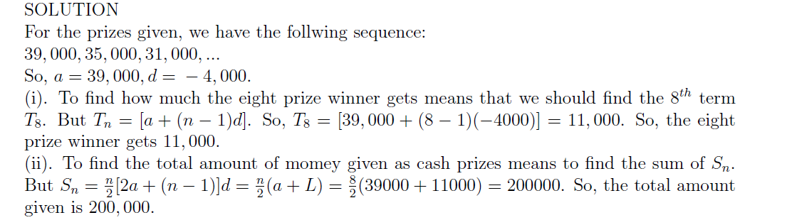
SOLUTION

Slide 9
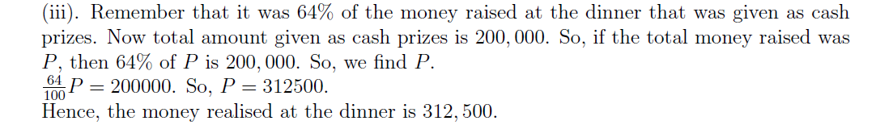
SOLUTION

Slide 10
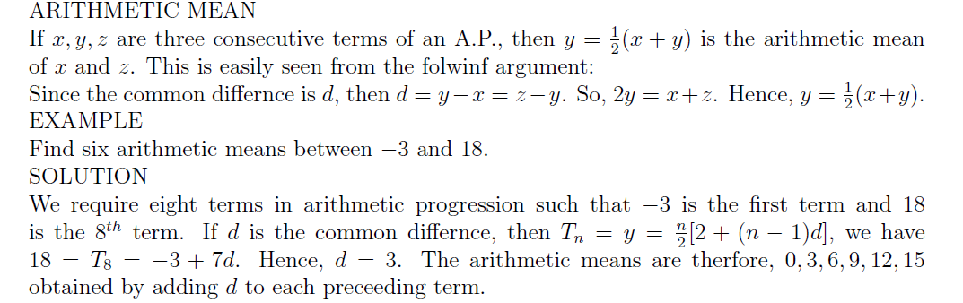
ARITHMETIC MEAN

Slide 11
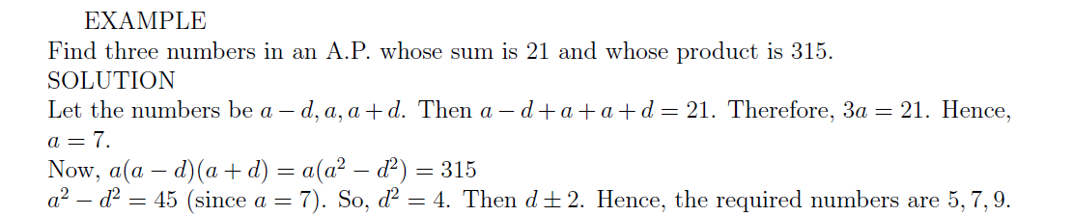
EXAMPLE

Slide 12
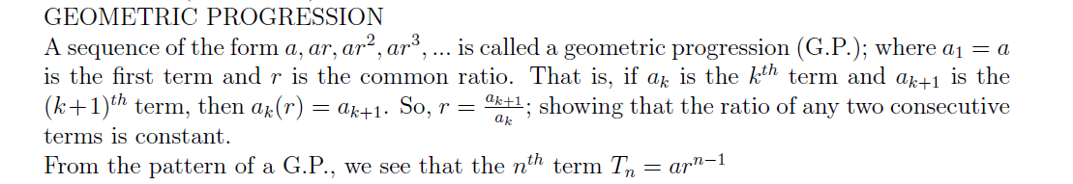
GEOMETRIC PROGRESSION

Slide 13
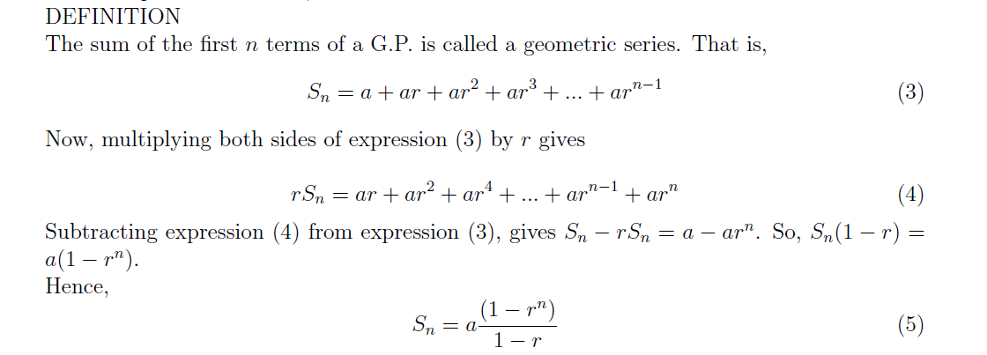
GEOMETRIC SERIES

Slide 14
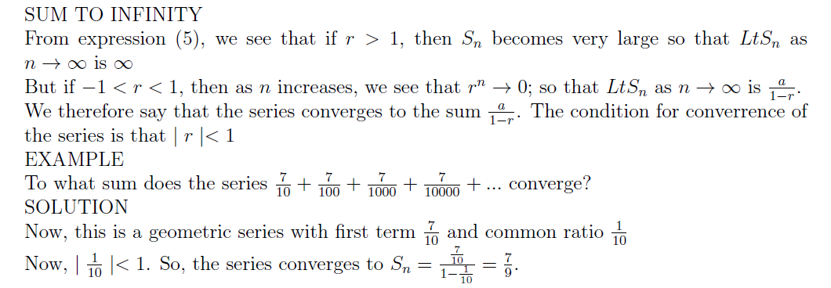
SUM TO INFINITY

Slide 15
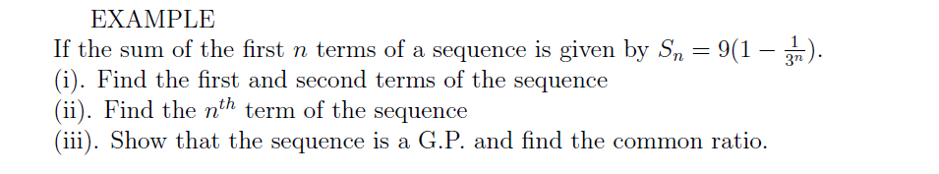
EXAMPLE

Slide 16
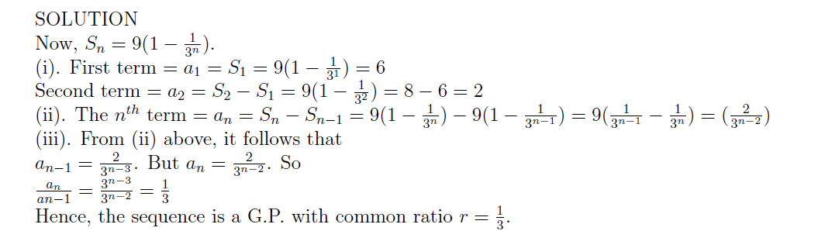
SOLUTION

Slide 17
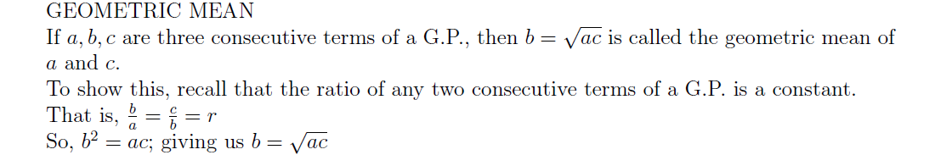
GEOMETRIC MEAN

Slide 18
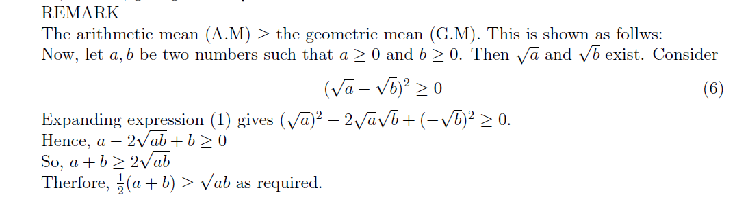
REMARK

Slide 19
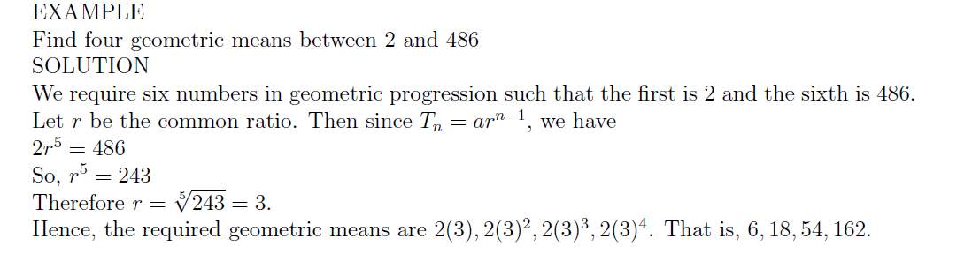
EXAMPLE

